Slide 1


Project Scope Management
PMP6 - v1.0

Slide 2

Our roles…
I am here as a facilitator
You are the PMP® exam candidates!

Slide 3
Objectives
Scope management process
Scope baseline
Project scope statement
WBS – WBS dictionary
Requirement traceability matrix
Work package, Product scope
Product analysis
Verified deliverable
Brainstorming
Nominal group technique
Delphi technique
Group decision making
Requirement categories
Context diagram
Prototype
Observation

Slide 4
Content
Project Scope Management
Plan Scope Management
Collect Requirements
Define Scope
Create Work Breakdown Structure
Validate Scope
Control Scope

Slide 5
1. Project Scope Management

Slide 6


> Overview
Scope definition
The sum of the products, services and results to be provided as a project
Project includes all work required, and only the work required, to complete the project successfully

Slide 7
> Overview
Project scope
The work performed to deliver a product, service, or result with specified features & functions.
Project scope statement
Product scope
The features and functions that characterize a product, service, or result
Product requirements
WBS & WBS dictionary
Product specification
Notes:
Project scope
The “How” => Work delivery oriented => Work that need to be done to deliver the product or the service
Product scope
- The “What” => Functional requirement or Product / Service => Feature & functions that characterize a product or service

Slide 8

> Overview
Importance of scope
Project team needs clear understanding of the work
Documentation is key to delivery
All documents should be accepted (sign-off)
Clear change control process must be followed for any changes

Slide 9

> Key concepts
Scope creep
Scope creep may also be called creep of scope
Scope creep can occur for a number of reasons, including:
A poor understanding of the original project
Changing market conditions
Competing forces within a company

Slide 10

> Key concepts
Scope creep
How to 5 Steps to Preventing Scope Creep
Understand the Outcome
Be Critical of Your Client’s Ideas
Clearly Define the Scope of Works
Price Right
Get It in Writing
Notes:
In a nutshell, the process for avoiding scope creep and keeping your clients happy is as follows:
Understand what your client wants to achieve
Collaborate with your client to produce a solution
Define the scope of works that will provide that solution
Price the solution in a manner that reduces the likelihood of overrun
Agree the details of the service delivery in writing

Slide 11
> Processes
5.1 Plan Scope Management
5.3. Define Scope
5.4. Create WBS
5.2. Collect Requirements
5.5 Validate Scope
5.6 Control Scope

Slide 12
> Processes
Initiating
Planning
Executing
Monitoring & Controlling
Closing
5.1. Plan Scope Management
5.2. Collect Requirements
5.3. Define Scope
5.4. WBS
5.5. Validate Scope
5.6. Control Scope

Slide 13
2. Plan Scope Management

Slide 14
> Overview
How scope is
Defined
Developed
Monitored
Controlled
Verified
It provides guidance & direction on how scope will be managed throughout the project lifecycle
TODO

Slide 15
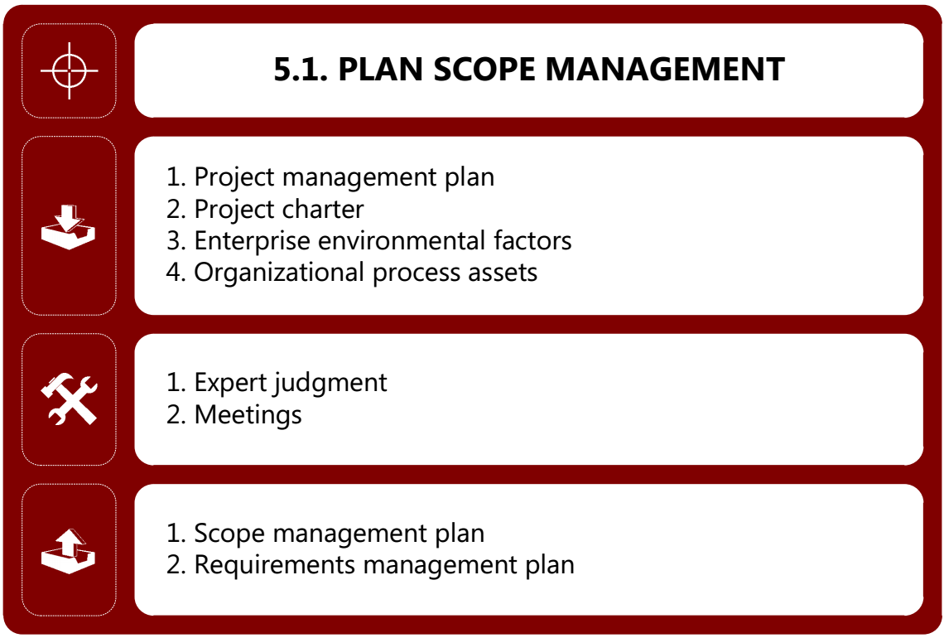
> ITTO
Notes:
ITTO: Input Tool & Technique Output

Slide 16
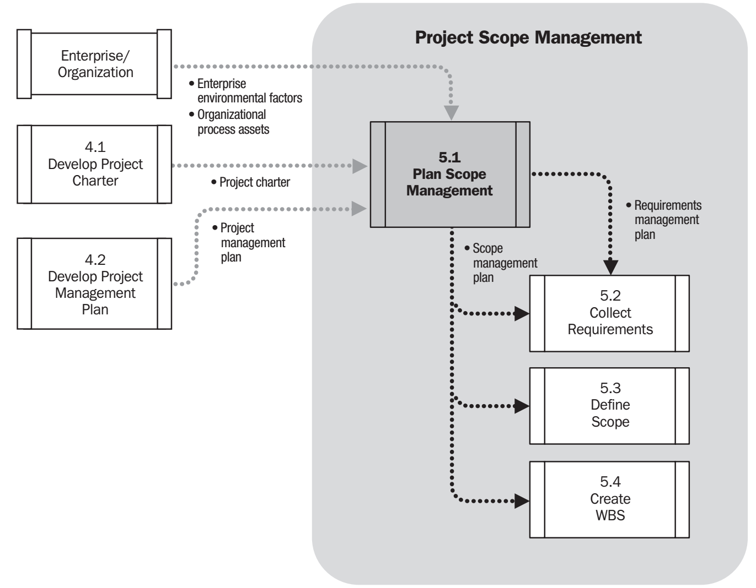
> Process Flow

Slide 17
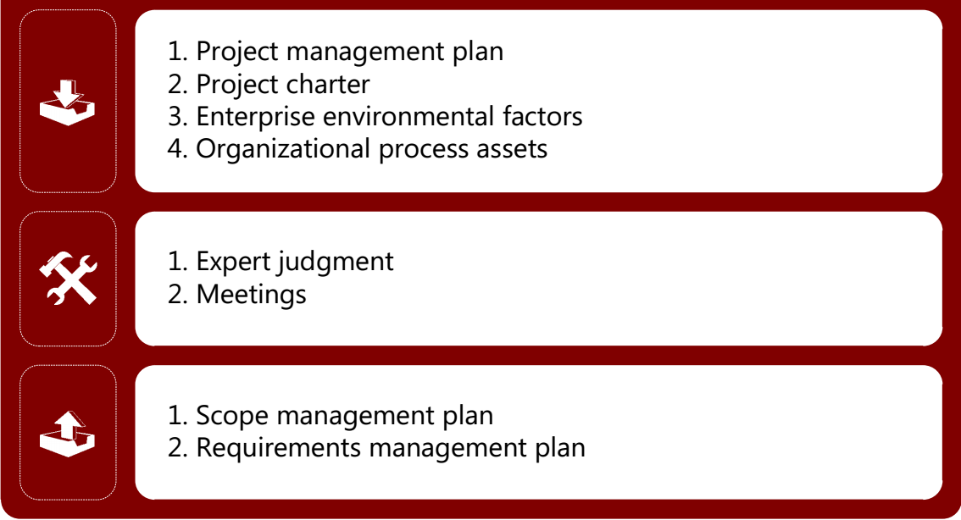
> Input
Notes:
ITTO: Input Tool & Technique Output

Slide 18
> Input
Project management plan
Approved subsidiary plans of PMP are used
Stakeholder management plan
Communication management plan
Risk management plan
It influence approach taken for planning & managing scope
Project charter
It provides the project context to plan the scope
Provides project description
Provides product characteristics

Slide 19
> Input
Enterprise Environmental Factors
Organization culture
Infrastructure
Resources
Organizational Process Assets
Policies & Procedures
Historical information
Lessons Learned

Slide 20
> Tool & Technique
Notes:
ITTO: Input Tool & Technique Output

Slide 21

> Tool & Technique
Expert Judgment
Input received from knowledgeable & experienced parties
It can be provided by group or person with specialized, education, knowledge, skills etc.

Slide 22

> Tool & Technique
Meetings
Project team may attend meetings
Project manager
Sponsor
Selected team members
Selected stakeholders
Any one with scope related responsibilities should attend meetings

Slide 23
> Output
Notes:
ITTO: Input Tool & Technique Output

Slide 24
> Output
Scope management plan
Contains how to
How to prepare detailed project scope statement
Enables the creation of the WBS
Establishes how WBS will be maintained and approved How formal acceptance of deliverables will be obtained How requests for changes will be controlled & processed

Slide 25
> Output
Requirement management plan
Requirement: A condition or capability that is required to be present in a product, service or result to satisfy customer needs.
Components of Requirement management plan
How to requirements activities will be planned, tracked & reported Configuration Management to initiate, track & report changes. Requirements prioritization process Product metrics that will be used and the rationale for using Which requirement attributes will be captured on traceability matrix
Refer to Template\3.3_Requirements Management Plan.doc

Slide 26
3. Collect Requirement

Slide 27
> Overview
Requirements are a set of demands, necessitates, needs, constraints highlighted by the stakeholders
Who collects requirements
Project Manager, Business analyst, System analyst, Quality analyst
Who provides requirements
Sponsor, Business users, IT operations, other stakeholder
Determining, documenting and managing stakeholder needs and requirements to meet project objectives
It provides the basis for defining & managing the project scope including product scope.

Slide 28
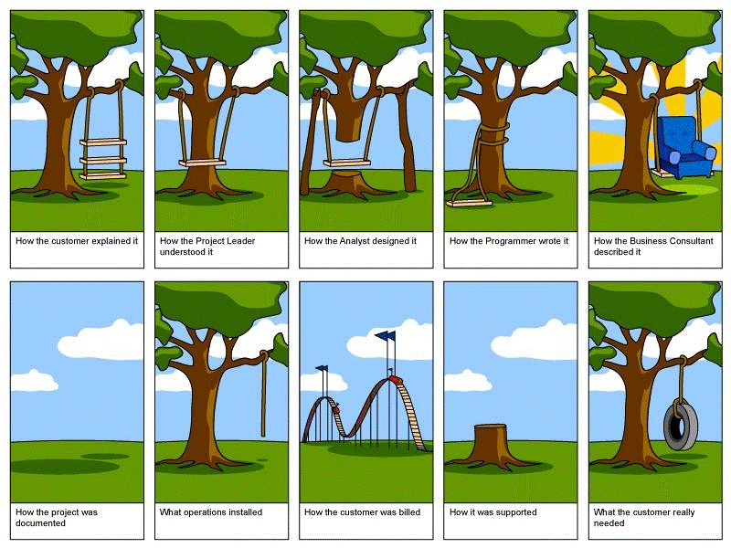
> Overview
The most difficult part of requirement gathering is not the act of recording what the users wants, it is the exploratory development activity or helping users to figure out what they want. (Story)

Slide 29
> Overview
Requirements classification
Business requirements
Stakeholder requirements
Solution requirements
Transition requirements
Project requirements
Quality requirement
Notes:
Business requirements: - Describe the higher-level needs of the organization - Business issues or opportunities, and reasons why a project has been undertaken.
Stakeholder requirements: - Describe needs of a stakeholder or stakeholder group.
Solution requirements: - Describe features, functions, and characteristics of the product, service, or result that will meet the business and stakeholder requirements.
Transition requirements: - Describe temporary capabilities, such as data conversion and training requirements, needed to transition from the current “as-is” state to the future “to-be” state
Project requirements: - Describe the actions, processes, or other conditions the project needs to meet.
Quality requirements: - Capture any condition or criteria needed to validate the successful completion of a project deliverable or fulfilment of other project requirements.

Slide 30
> Overview
Solution requirements are further grouped into
Functional requirements
Describe the behavior of the product
Non-functional requirement
Describe the environmental conditions or qualities required for the product to be effective
Example: TODO
Example: TODO

Slide 31
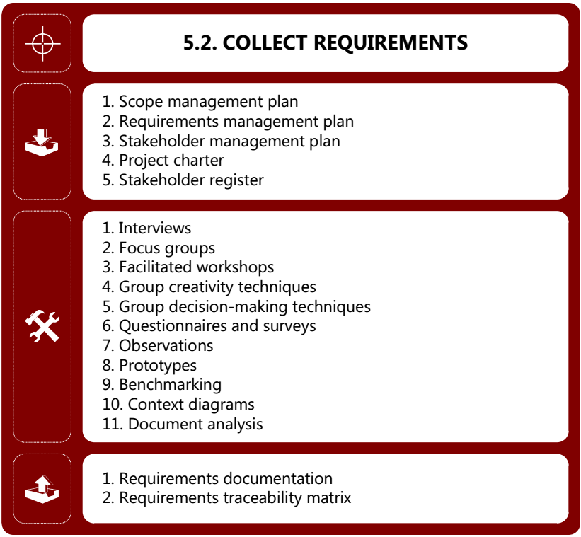
> ITTO
Notes:
ITTO: Input Tool & Technique Output

Slide 32
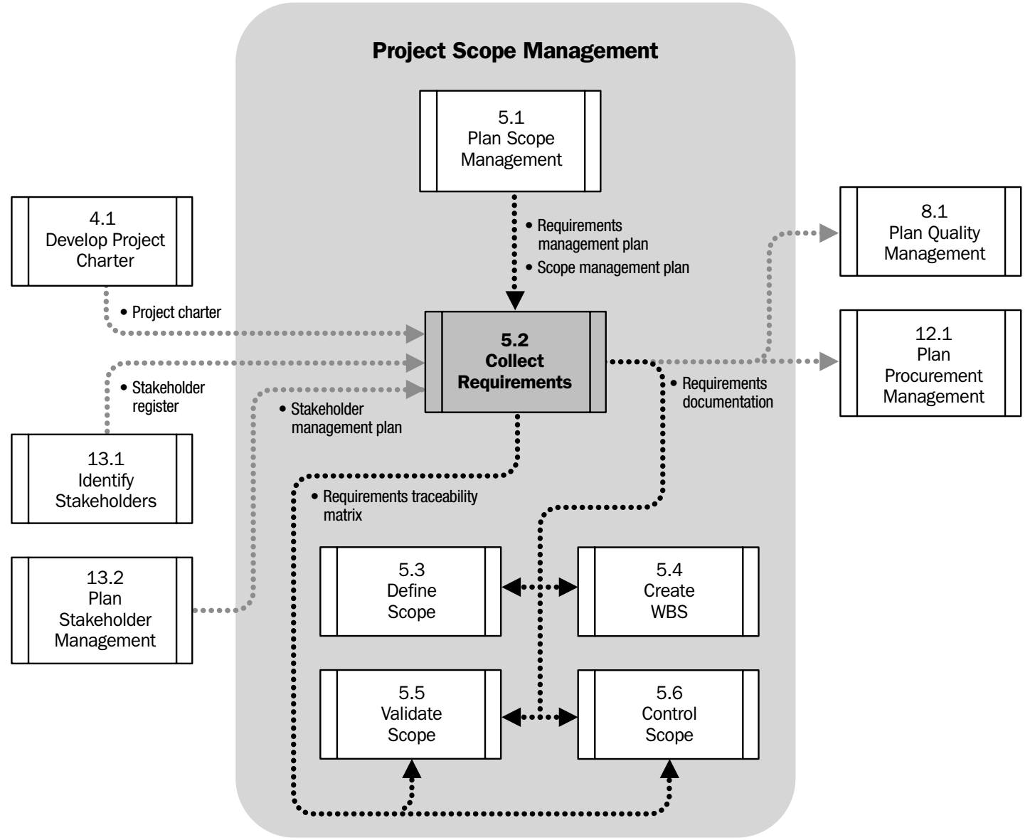
> Process Flow

Slide 33
> Input
Notes:
ITTO: Input Tool & Technique Output

Slide 34
> Input
Scope management plan
How scope will be defined, developed, monitored, controlled and verified
Refer to “Plan scope management” process
Requirement management plan
A condition or capability that is required to be present in a product, service, or result to satisfy customer needs
Refer to “Plan scope management” process

Slide 35
> Input
Stakeholder management plan
Understand stakeholder communication requirements Level of stakeholder engagement Helps to ensure stakeholder participation
Project charter
It provides the project context to plan the scope.
Provides project description
Provides product characteristics.
Refer to Template\2.2_Project Charter.doc

Slide 36
> Input
Stakeholder register
Identify stakeholder who can provide information on requirements Capture major stakeholder requirements Capture key expectations.
Refer to Template\2.3_Stakeholder Register.doc

Slide 37
> Tool & Technique
Notes:
ITTO: Input Tool & Technique Output

Slide 38
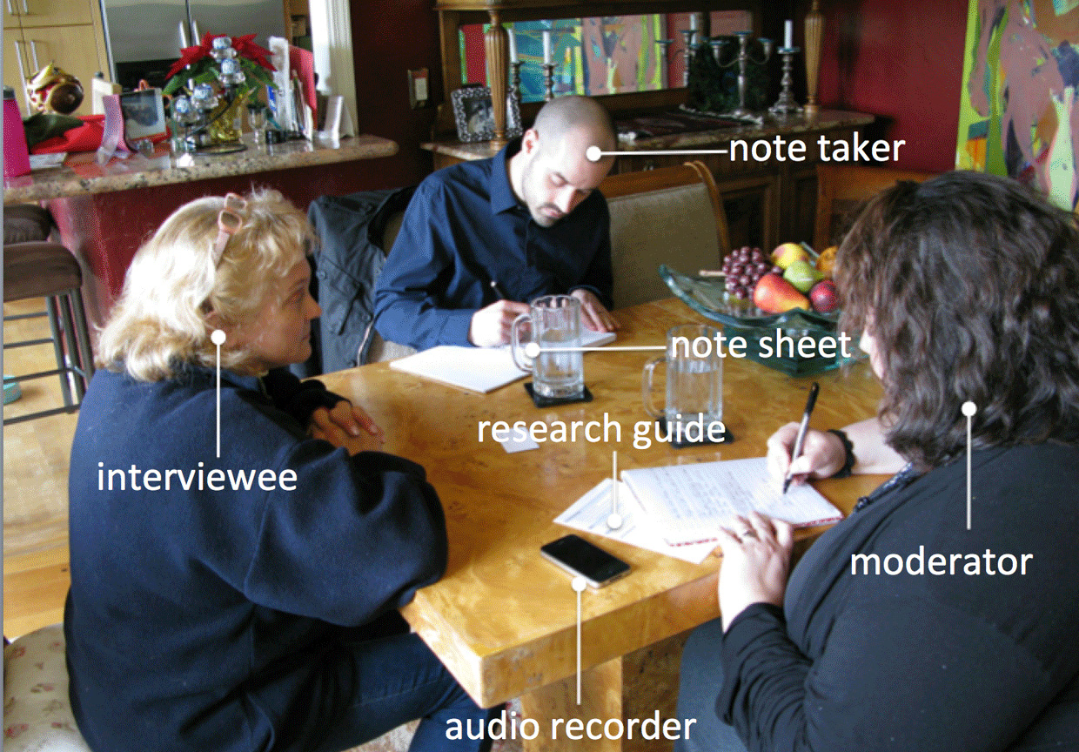
> Tool & Technique
Interviews
Approach to elicit information from stakeholders by talking to them directly
Spontaneous questions Obtain confidential information

Slide 39

> Tool & Technique
Focus groups
Bring together prequalified stakeholders & SME to understand their expectations & attitudes. Trained moderator develop a discussion by asking predefined questions. Discussion is focused around a topic.
Pros
Has fix agenda
More structured
Cons
Trained moderator required
Less control

Slide 40
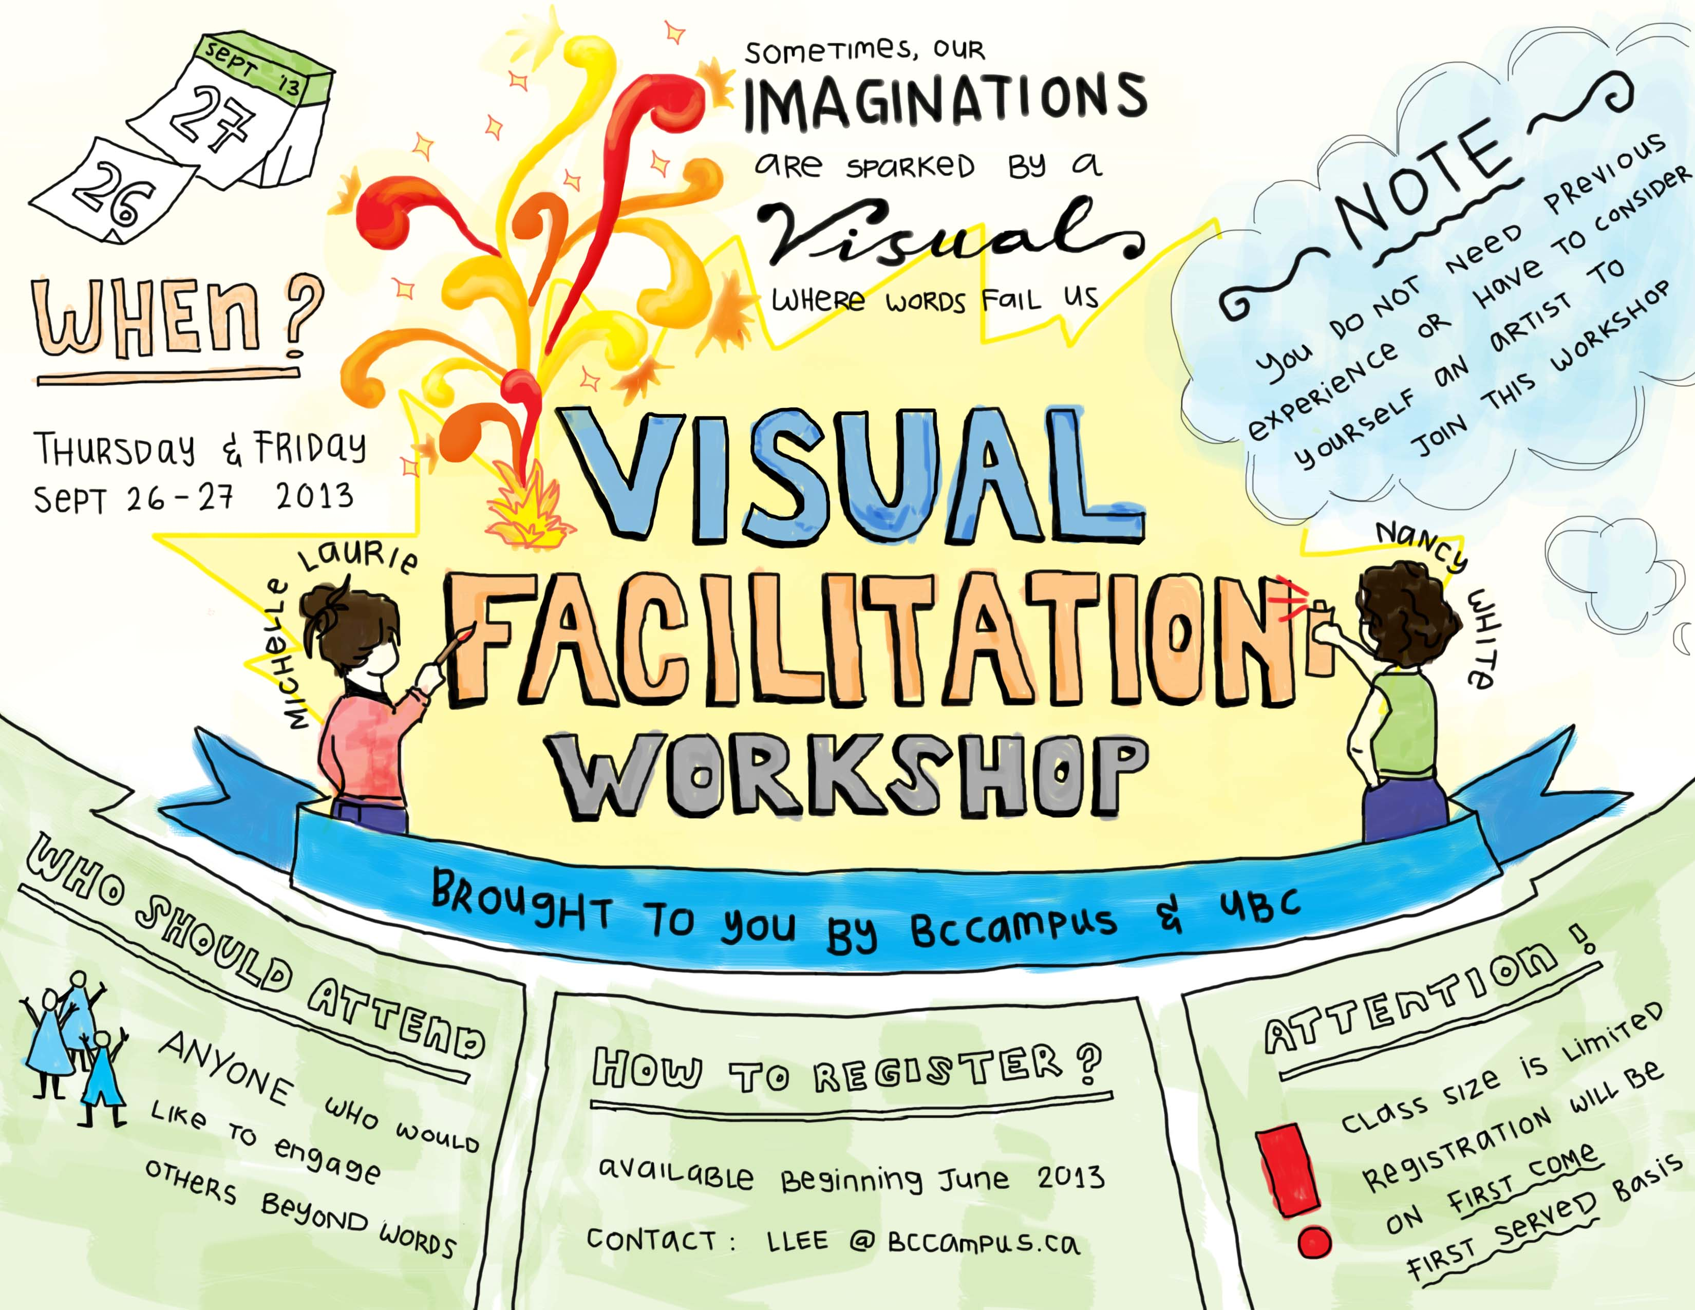
> Tool & Technique
Facilitated workshop
Joint Application Design/Development (JAD)
Software development industry
Bring SME & development team together
Quality function deployment (QFD)
User story
Notes:
Quality Function Deployment (QFD) - Used in manufacturing industry. - Determine critical characteristics for new products. - Starts by collecting customer needs (Voice of Customer) - Needs are then objectively sorted & prioritized.
User stories : - User stories are widely used with agile methods. - Describe: - The stakeholder who benefits from the feature (role) - What the stakeholder needs to accomplish (goal) - The benefit to the stakeholder (motivation)

Slide 41

> Tool & Technique
Group creativity techniques
Techniques that are used to generate ideas within a group of stakeholders. Several group activities can be organized to identify product & project requirements.
Brainstorming
Affinity diagrams (KJ method)
Nominal group techniques
Idea/mind mapping
Multi-criteria decision

Slide 42

> Tool & Technique
Group creativity techniques
Brainstorming
To generate and collect Multiple ideas related to project and product requirements
Brainstorming stages
Problem Identification
Idea Generation
Idea Selection (decision making)
Implementation

Slide 43
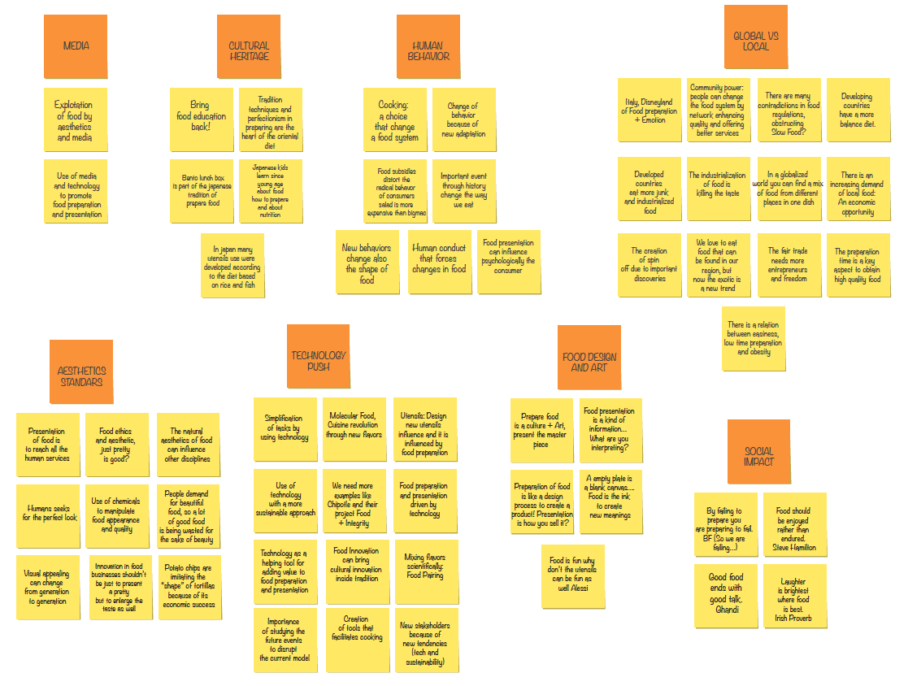
> Tool & Technique
Group creativity techniques
Affinitive diagram (KJ method)
Allows large numbers of ideas to be CLASSIFIED into groups for review and analysis
Step by step to implement
Identify problem
List Idea / issues
Create affinities
Identify groups
Analyze results
USE IT: Going Through Large Volumes of Data. Stimulate Idea Generation & new Patterns of Thinking
AVOID IT: When the data sets available are small in number (less than 15)
Notes:
Brainstorming: To generate and collect Multiple ideas related to project and product requirements.
Affinity Diagram
Allows large numbers of ideas to be CLASSIFIED into groups for review and analysis.

Slide 44
> Tool & Technique
Group creativity techniques
Nominal group techniques
Nominal group techniques: Enhances brainstorming with a VOTING process used to rank most useful ideas for further brainstorming or for prioritization
Use it
When some group members are much more vocal than others. When some group members think better in silence. When the group does not easily generate quantities of ideas. When all or some group members are new to the team. When the issue is controversial or there is heated conflict

Slide 45
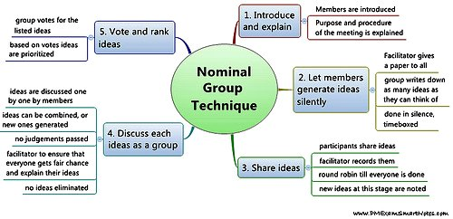
> Tool & Technique
Group creativity techniques
Nominal group techniques (cont.)

Slide 46
> Tool & Technique
Group creativity techniques
Multi-criteria decision analysis
Utilizes a decision MATRIX to provide a systematic analytical approach for establishing criteria, such as risk levels, uncertainty, to evaluate & rank ideas
It is most applicable to solving problems that are characterized as a choice among alternatives.
Dividing the decision into smaller
Analyzing each part
Integrating the parts to produce a solution

Slide 47
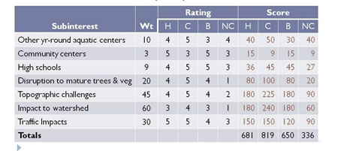
> Tool & Technique
Group creativity techniques
Multi-criteria decision analysis

Slide 48
> Tool & Technique
Group decision-making techniques
Assess multiple alternatives that will be used to generate, classify, and prioritize product requirements
4 type of decisions
Unanimity: EVERYONE agrees on a single course of action. (Delphi technique)
Majority: Agree more than 50 % of the members of the group
Plurality: LARGEST block in a group decides, even if a majority is not achieved
Dictatorship: ONE individual makes the decision for the group

Slide 49
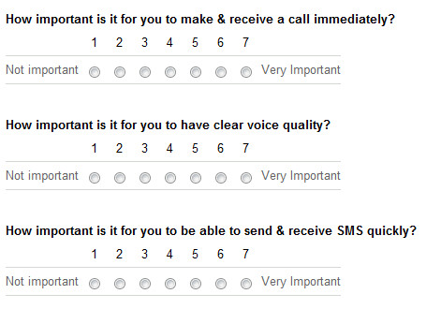
> Tool & Technique
Questionnaires and surveys
These are written set of questions designed to quickly accumulate information from large number of respondents
Most appropriate with varied audiences Used when Quick turnaround is needed Used when respondents are geographically dispersed Statistical analysis is appropriate

Slide 50

> Tool & Technique
Observations
Provides a direct way of viewing individuals in their environment performing their jobs & carrying out processes
Generally Observer see what he expects to see Hawthorne Effect: Short term improvement in observing worker Helpful for dealing with processes, when people that use product have difficulty or are reluctant to articulate their requirements.

Slide 51


> Tool & Technique
Prototypes
A working model of the expected product. Early feedback on requirements. Tangible, it allows real experiment

Slide 52

> Tool & Technique
Benchmarking
Comparing actual or planned practices, such as processes & operations, to those of comparable organizations
Used
Identify best practices
Generate ideas for improvement
Basis for measuring performance
The organizations compared during benchmarking can be internal or external

Slide 53
> Tool & Technique
Context diagrams
Visually depict the product scope by showing a business system (process, computer system), & how people & other systems interact with it.
Show inputs/output to business system
Actor(s) providing input
Outputs from business system
& actor(s) receiving output
No technical knowledge is required to understand
Can benefit a wide audience

Slide 54
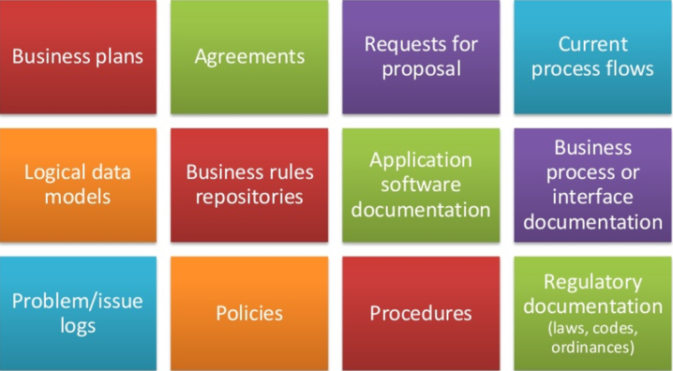
> Tool & Technique
Document analysis
Elicit requirements by analyzing existing documentation Identifying information relevant to requirements

Slide 55
> Output
Notes:
ITTO: Input Tool & Technique Output

Slide 56
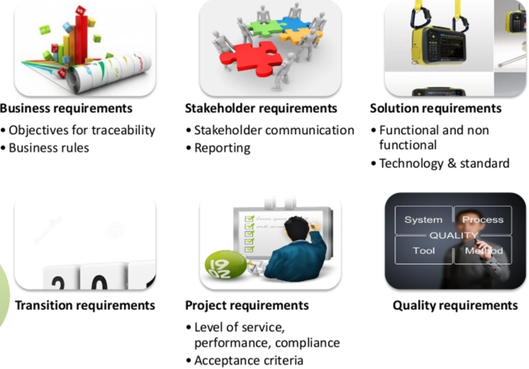
> Output
Requirements document
It describes how individual requirements meet the business need for the project

Slide 57
> Output
Requirements traceability matrix
RTM is a grid that links product requirements to deliverables that satisfy them. Ensure each requirement adds business value by linking it to business objectives. Track requirements throughout project life cycle Provides a structure for managing changes to the product scope
Refer to Template\3.4_Requirement Tracebility Matrix.doc

Slide 58
> Output
Requirements traceability matrix
Tracing includes, but is not limited to, tracing requirements for the following
Business needs, opportunities, goals, and objectives
Project objectives
Project scope/WBS deliverables
Product design
Product development
Test strategy and test scenarios
High-level requirement to more detailed requirements

Slide 59
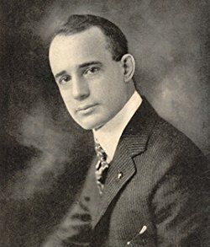
Napoleon Hill
“What the mind can conceive it can achieve”

Slide 60
4. Define Scope

Slide 61
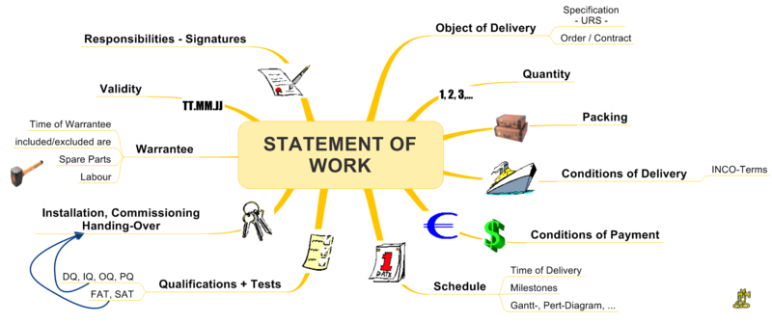
> Overview
Process of developing a detailed description of the project and product
Describes project, service or result boundaries by defining which of requirements collected will be included & excluded

Slide 62
> Overview
Provide detailed understanding of requirements to be delivered as part of project
Provide description of Product, Service or results
Define Requirements - Inclusion & Exclusion
Develop final project scope statement

Slide 63
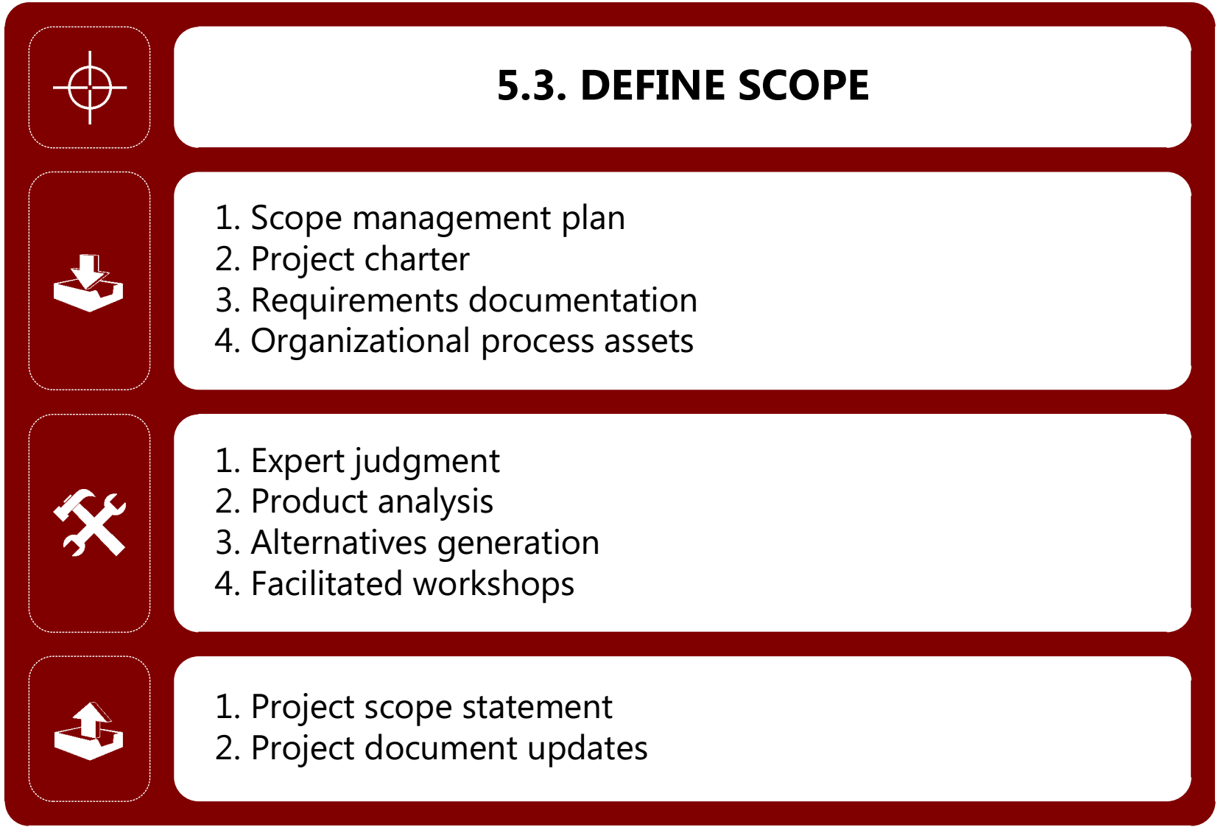
> ITTO

Slide 64
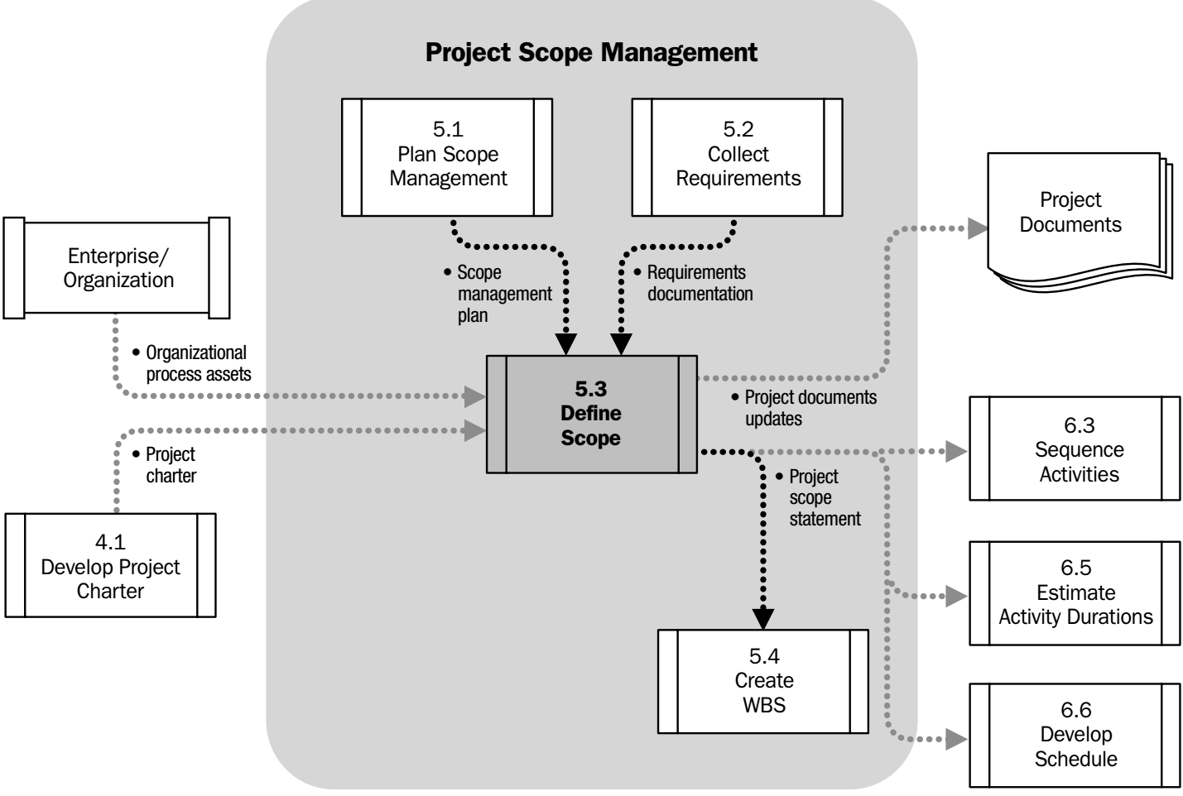
> Process Flow

Slide 65
> Input
Notes:
ITTO: Input Tool & Technique Output

Slide 66
> Input
Scope management plan
It defines boundaries & framework to define the project scope
Control how requests for changes will be processed
Define scope
New/Change Requirement
Raise change request
Perform integrated change control
Elaborate scope

Slide 67
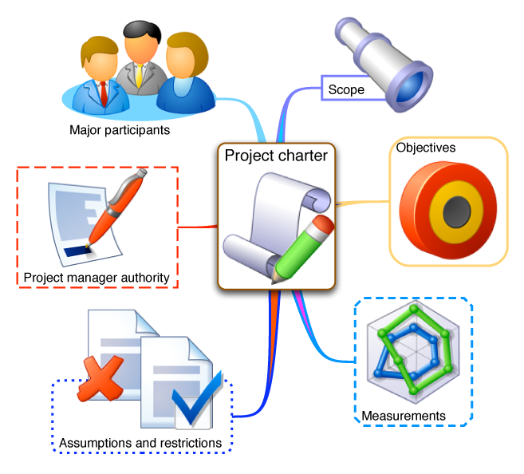
> Input
Project charter
Formally authorizes a project & provide PM with authority to apply org. resources to project activities It contains
Project Purpose or Justification Measurable objectives & success criteria High level requirements,
High level project description High level risks, Stakeholder list Project approval requirements
Refer to Template\2.2_Project Charter.doc

Slide 68
> Input
Requirement documents
It describes how individual requirements meet the business need for the project
Refer to Template\3.2_Requirements Documentation.doc
Organizational Process Assets

Slide 69
> Tool & Technique
Notes:
ITTO: Input Tool & Technique Output

Slide 70
> Tool & Technique
Expert judgment
It is often used to analyze the information used to develop the project scope statement
Examples
Subject master experts
Consultants & Contractors
Stakeholders, including customers or sponsors

Slide 71
> Tool & Technique
Product analysis
Product analysis can be an effective tool evaluate product. Especially, when product is output of the project Improve the project teams understanding of the Product
Translating high-level product descriptions into tangible deliverables
Examples
Product breakdown System analysis
Requirement analysis System engineering
Value engineering Value analysis
Notes:
Value engineering
Optimize the overall value of the project. Use creative strategies. Aim is to achieve the lowest life cycle cost.
Value analysis
- Cost reduction tool that considers whether function is really necessary. - Decide whether it can be achieved at a lower cost without degrading performance or quality. - Finding least expensive way to deliver scope.

Slide 72
> Tool & Technique
Alternatives generation
Develop as many potential OPTIONS as possible in order to identify different approaches to execute and perform the work of the project Includes techniques such as
Brainstorming
Lateral thinking
Analysis of alternative
Notes:
Contractor conferences
Vendor conference
Pre-Bid conferences

Slide 73
> Tool & Technique
Facilitated workshops
Objective is to develop a consensus for defining scope
Cross functional team members are involved, can quickly defining cross functional requirements
Notes:
Contractor conferences
Vendor conference
Pre-Bid conferences

Slide 74
> Output
Notes:
ITTO: Input Tool & Technique Output

Slide 75
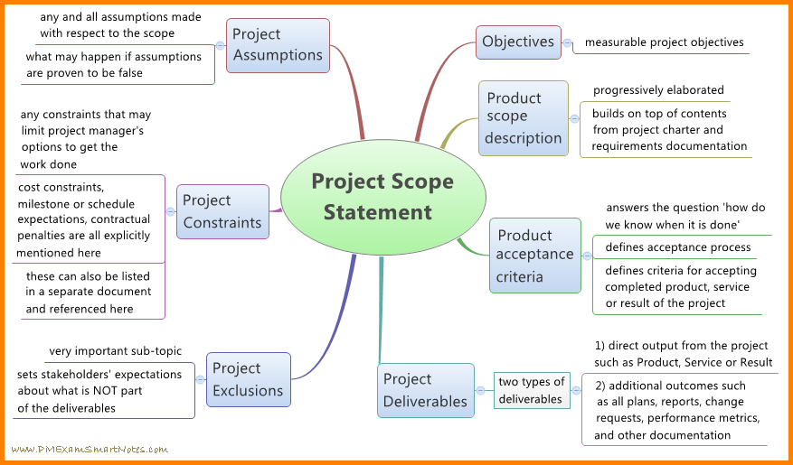
> Output
Project scope statement
It is the description of the project scope major deliverables, assumptions & constraints

Slide 76
> Output
Project document updates
Project documents updates are required due to change in scope
Updates
Stakeholder register
Requirement documents
Requirement traceability matrix

Slide 77
5. Create Work Breakdown Structure

Slide 78
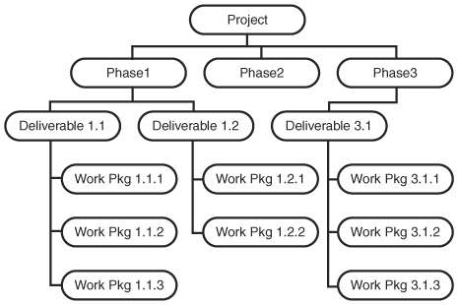
> Overview
Subdividing project deliverables & project work into smaller, more manageable components

Slide 79
> Overview
Work break down structure
Subdivide project’s deliverables & scope
Its hierarchical
Helps to accomplish project objectives
Work package: lowest level of WBS
100% Rule:
WBS contains 100% of the project scope no additional tasks are added
It contains all project deliverables
If something is not in WBS then it is not a part of the project

Slide 80
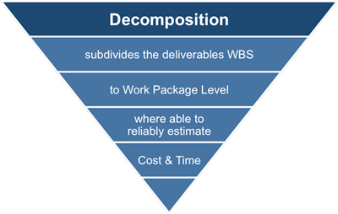
> Overview
How WBS is created & used?
Define project scope
Decompose scope
Create work packages
Assign to project team members

Slide 81
> Overview
Control account
Management control point where scope, budget, actual cost, & schedule are integrated & compared to earned value
Project
Control account 1
Planning Package 1
Planning package 2
Control account 2
Planning Package 3
Project
Control account
Planning package
Work package
Work package 1
Work package 2

Slide 82
> Overview
Planning packages
A work breakdown structure component below the control account with known work content but without detailed schedule activities
Control accounts are placed at selected management points in the WBS
Each control account may include one or more planning & work packages
Each of the work packages should be associated with only one control account
Project
Control account 1
Planning Package 1
Planning package 2
Control account 2
Planning Package 3
Project
Control account
Planning package
Work package
Work package 1
Work package 2

Slide 83
> Overview
Work packages
The work defined at the lowest level of the work breakdown structure for which cost and duration can be estimated and managed
Work package gets converted to activities
General rule for size of work package – 8 to 80 hours
Project
Control account 1
Planning Package 1
Planning package 2
Control account 2
Planning Package 3
Project
Control account
Planning package
Work package
Work package 1
Work package 2

Slide 84
> Overview
WBS Dictionary
Provides detailed deliverables, activity, & scheduling information about each component in the WBS
WBS Dictionary
Code of account identifier
Description of the work
Responsibilities - Milestones
Resources - Cost
Refer to Template\3.8_WBS Dictionary.doc

Slide 85
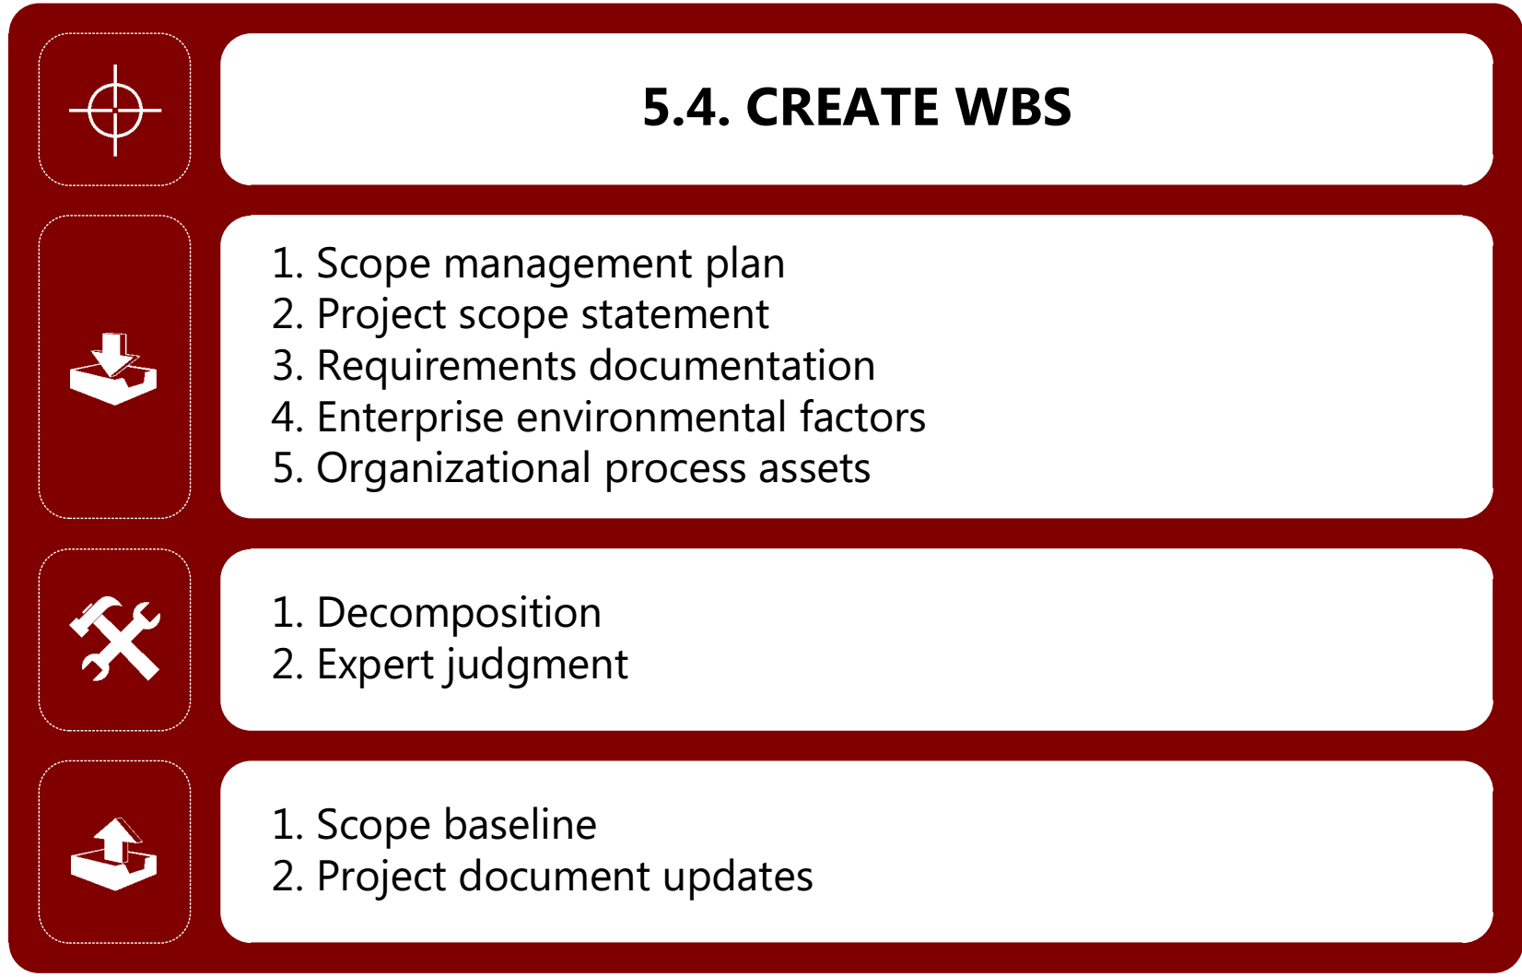
> ITTO

Slide 86
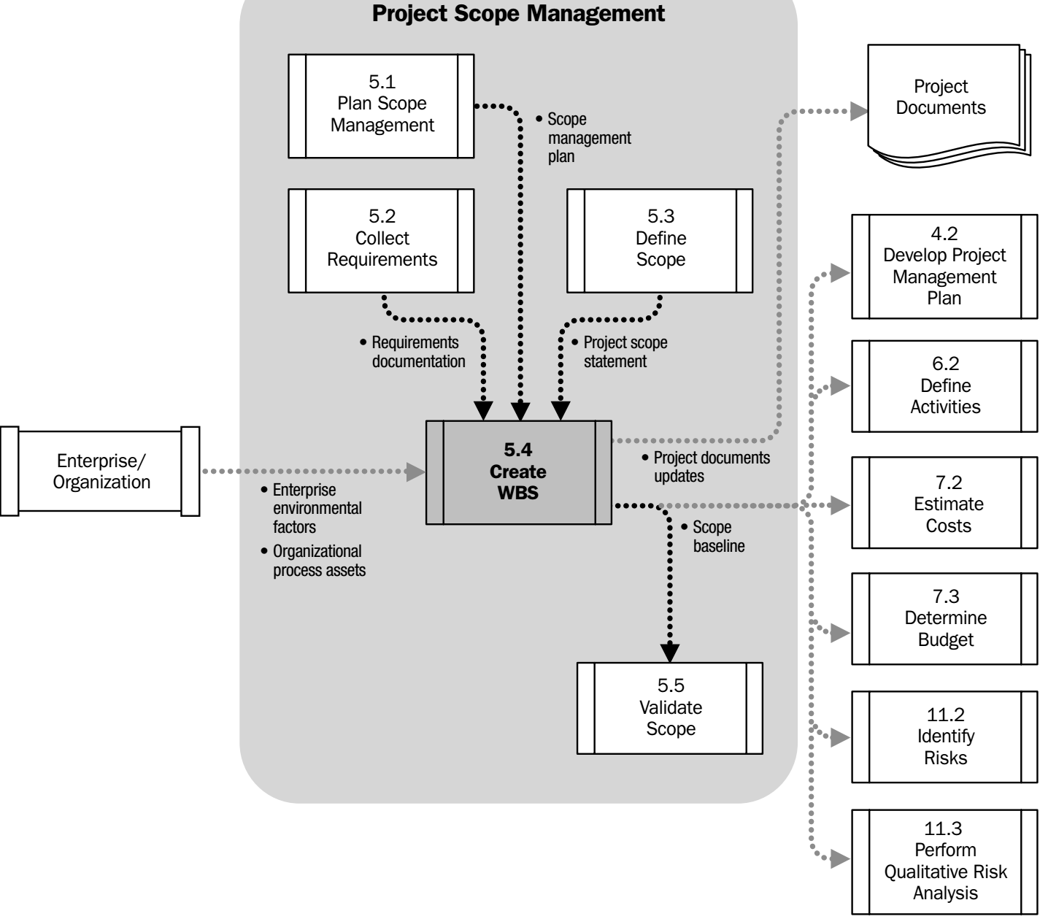
> Process Flow

Slide 87
> Input
Notes:
ITTO: Input Tool & Technique Output

Slide 88
> Input
Scope management plan
It defines boundaries & framework to define the project scope
Control how requests for changes will be processed
Project scope statement
It is the description of the project scope major deliverables, assumptions, & Constraints
Refer to the previous process

Slide 89
> Input
Requirements documentation
It describes how individual requirements meet the business need for the project
Refer to the previous process

Slide 90
> Input
Enterprise environmental factors
Industry specific WBS standards
Organizational process assets
Policies, procedure & templates
Project files from previous projects
Lesson learned

Slide 91
> Tool & Technique
Notes:
ITTO: Input Tool & Technique Output

Slide 92
> Tool & Technique
Decomposition
Dividing and subdividing project scope & project deliverables in to smaller & more manageable parts
If work is decomposed to greater level of details, the ability to plan, manage & control work is enhanced
Excessive decomposition lead to non-productive management efforts, inefficient use of resources, decrease in efficiency
May not be possible for a deliverable or subcomponent that will be accomplished for into the future

Slide 93
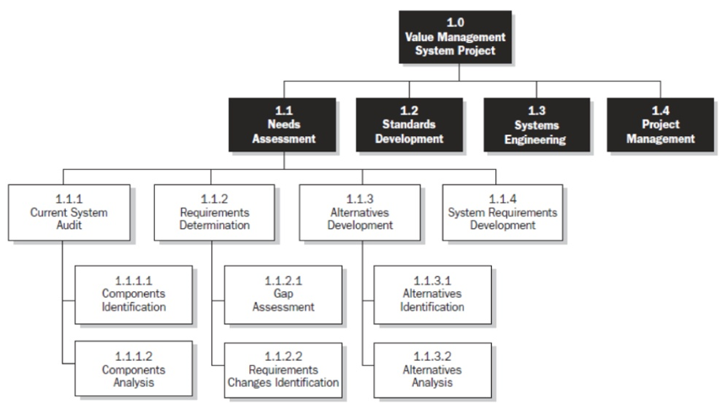
> Tool & Technique
Decomposition
100% rule: The total of the work at lowest levels should roll up to the higher levels so that nothing is left out
WBS decomposed down through Work packages

Slide 94
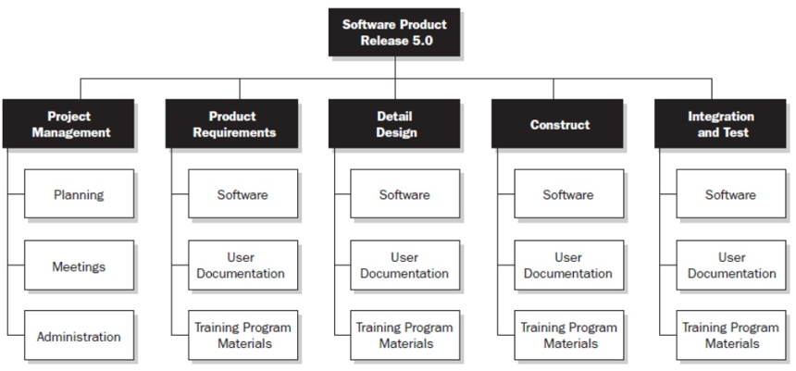
> Tool & Technique
Decomposition
WBS decomposed down through Phase

Slide 95
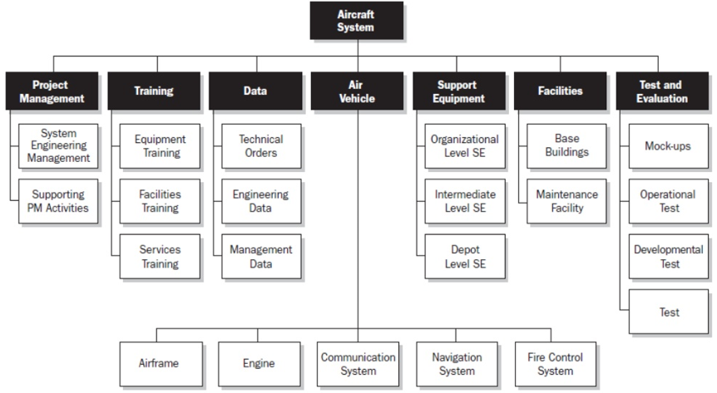
> Tool & Technique
Decomposition
WBS decomposed by major deliverables

Slide 96
> Tool & Technique
Expert Judgment

Slide 97
> Output
Notes:
ITTO: Input Tool & Technique Output

Slide 98

> Output
Scope baseline
Approved version of a scope statement, WBS & its associated WBS dictionary
This can be changed only through formal change control procedures
It is used as a basis for comparison
Notes:
+ Project scope statement
Description of the project scope, major deliverables, assumptions, and constraints
+ Work breakdown structure (WBS)
A hierarchical decomposition of the total scope of work to accomplish the project objectives and create the required deliverables
+ Work breakdown structure dictionary
Provides detailed deliverable, activity, and scheduling information about each component in the WBS
➔ Scope baseline

Slide 99
> Output
Scope baseline
WBS dictionary: refer to Template\3.8_WBS Dictionary.doc
Project document updates

Slide 100
6. Validate Scope

Slide 101
> Overview
Formalizing acceptance of completed project deliverable, at the end of each phase or project
It brings objectivity to acceptance process & increases change of final product, service, or result acceptance
This process is primarily concerned with acceptance of the deliverables

Slide 102
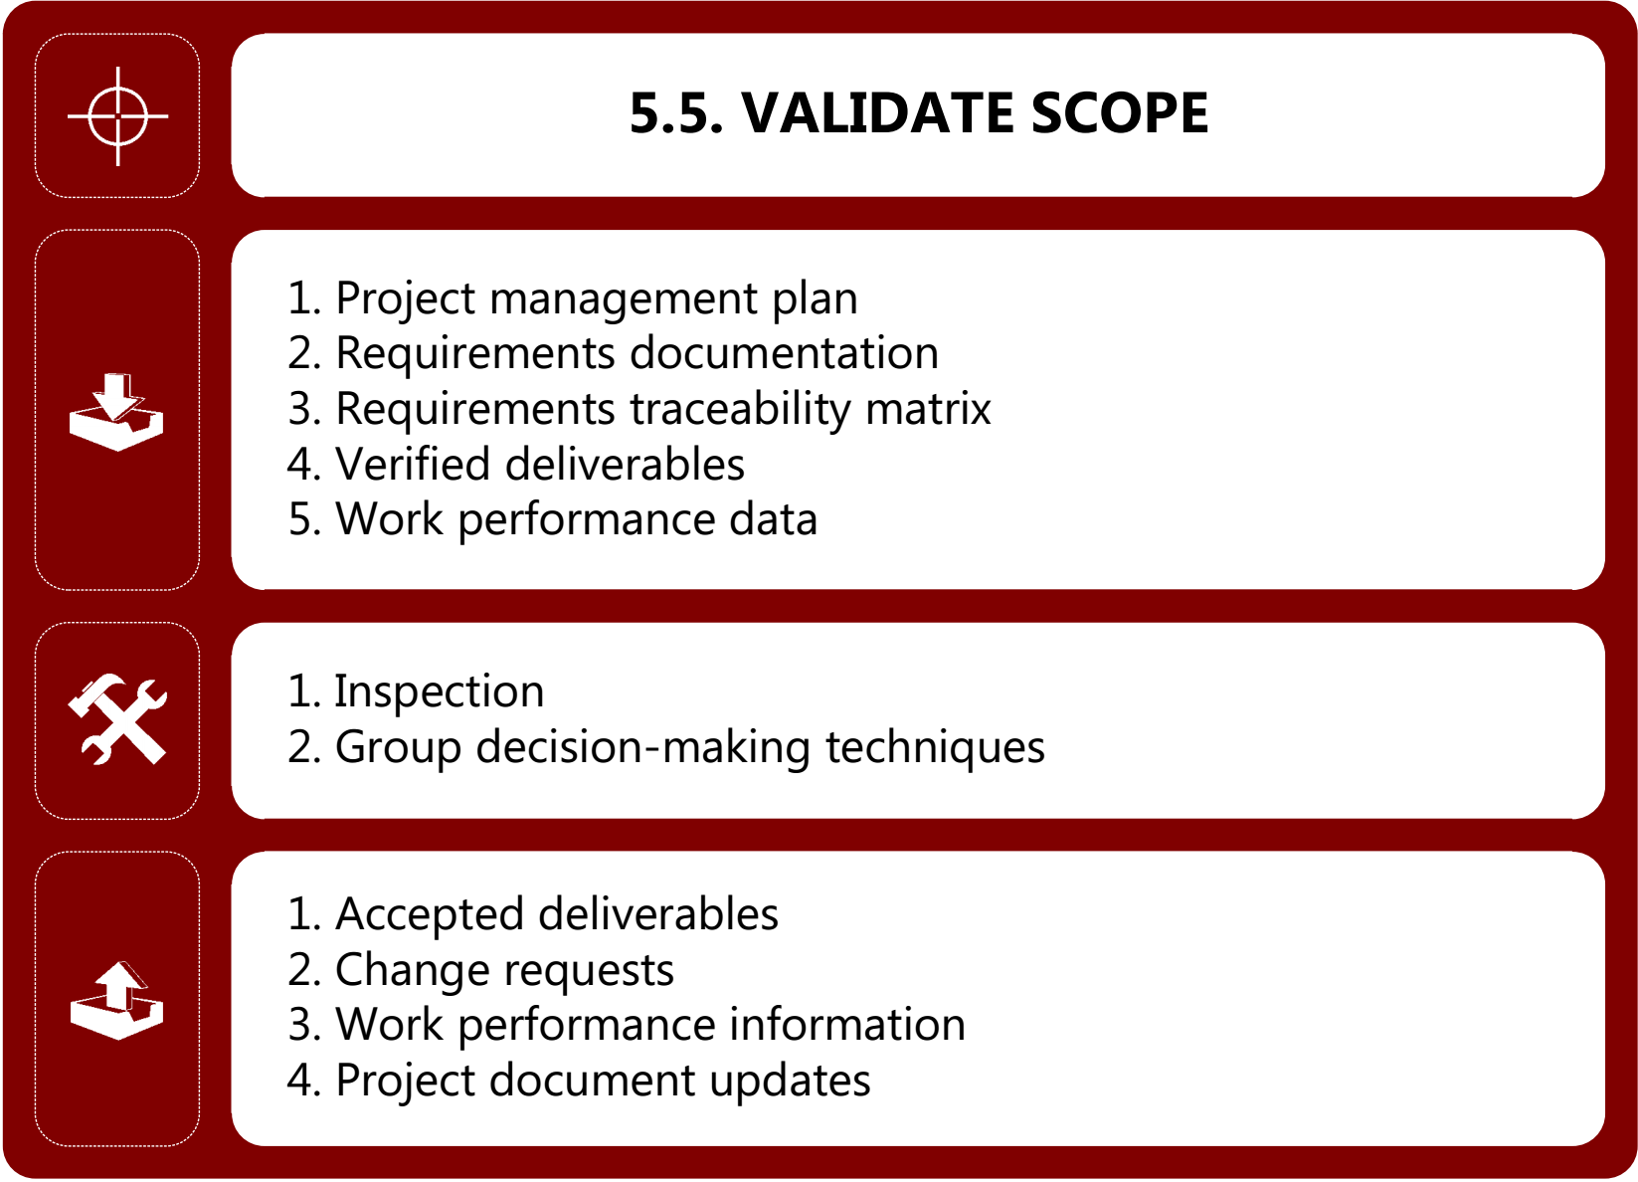
> ITTO
Notes:
ITTO: Input Tool & Technique Output

Slide 103
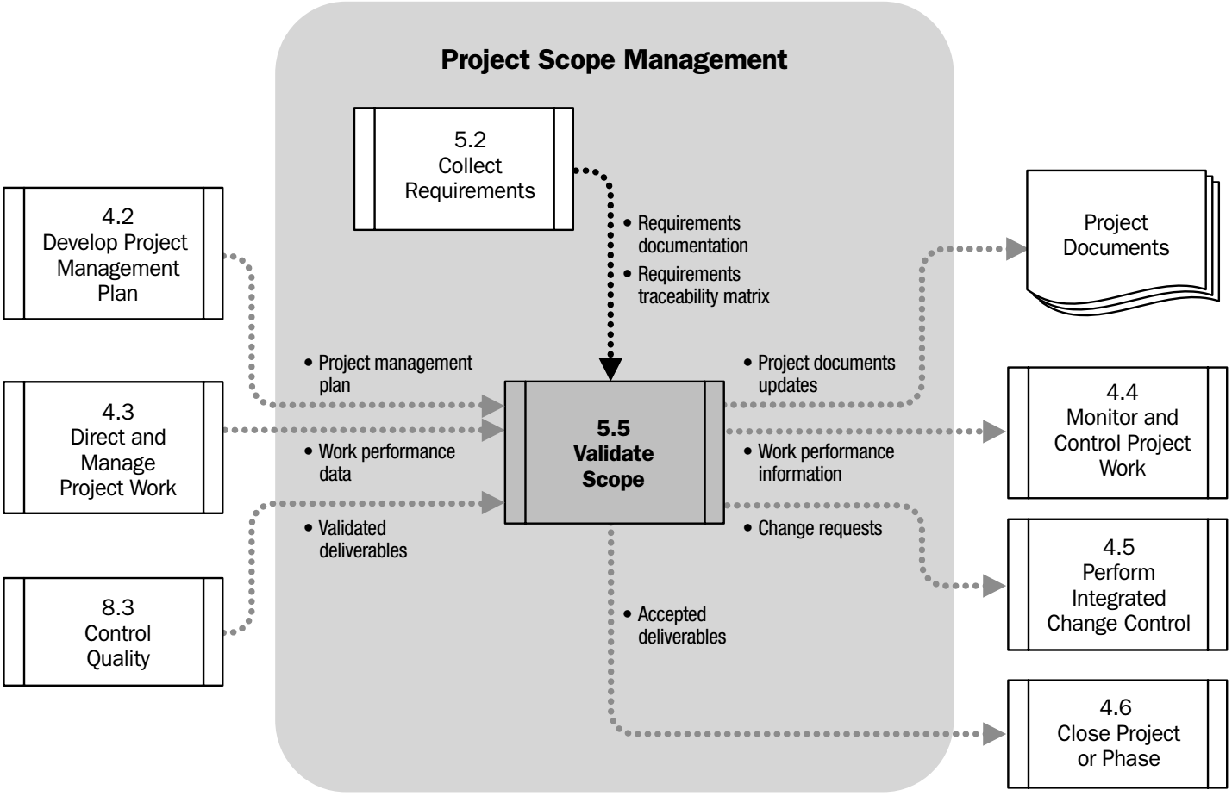
> Process Flow

Slide 104
> Input
Notes:
ITTO: Input Tool & Technique Output

Slide 105
> Input
Project management plan
Scope management plan specifies how to obtain formal acceptance of the completed project deliverables + the scope baseline
Requirements documentation
List all the project, product, and other types of requirements for the project and product, along with their acceptance criteria

Slide 106
> Input
Requirements traceability matrix
Links requirements to their origin and tracks them throughout the project life cycle
Verified deliverables
Project deliverables that are completed and checked for the correctness through the Control Quality process
Work performance data
Including degree of compliance with requirements, number of nonconformities, severity of nonconformities, or number of validation cycles performed

Slide 107
> Input
Deliverable expected – Planning phase
Project management plan
Product service or result delivered – Build phase
Verified deliverables
Work performance data
Requirement documentation
Req. Traceability matrix
Scope plan
Scope baseline
Requirements
Acceptance criteria’s
Control Quality
Ready for approval
Non-conformance details

Slide 108
> Tool & Technique
Notes:
ITTO: Input Tool & Technique Output

Slide 109


> Tool & Technique
Inspection
Includes activities such as measuring, examining, & validating to determine whether work & deliverables meet acceptance criteria
Inspection are sometimes called reviews, product reviews, audits and walkthroughs

Slide 110
> Tool & Technique
Inspection
Deliverable expected vs Actual deliverable
Customer validation
Compare with requirements/specifications (actuals with expected)
Identify & Document non conformance

Slide 111
> Tool & Technique
Group decision-making techniques
Group discuss & reaches conclusion after scope validation

Slide 112
> Output
Notes:
ITTO: Input Tool & Technique Output

Slide 113
> Output
Accepted deliverables
Formal documentation received from customer or sponsor acknowledging formal acceptance of the deliverables
This is forwarded to the Close Project or Phase process
Deliverables that MEET the acceptance criteria are formally signed off and approved by the customer or sponsor
Change requests
The completed deliverables that have NOT been formally accepted are documented, along with the reasons for non-acceptance of those deliverables

Slide 114
> Output
Work performance information
It includes information about project progress, such as which deliverables that have started, finished or which have been accepted
Project document updates
Any document that defines the product or report status or product completion

Slide 115
Napoleon Hill
“The way of success is the way of continuous pursuit of knowledge”

Slide 116
4. Control Scope.

Slide 117
> Overview
Monitoring the status of the project and product scope and managing changes to the scope baseline
It allows the scope baseline to be maintained throughout the project
Change is inevitable; therefore some type of change control process is mandatory for every project
Controlling project scope ensures all requested changes & recommended corrective or preventive actions are processed through the Perform Integrated Change Control process

Slide 118
> Overview
Control Scope is also used to manage the actual changes when they occur and is integrated with other control processes such as Perform Integrated change control, Monitor & Control project work ➔ AVOID SCOPE SCREEP

Slide 119
> Overview
Scope creep
Scope creep may also be called creep of scope or the uncontrolled expansion to product or project scope without adjustments to time, cost, and resources.
Scope creep can occur for a number of reasons, including:
Poorly defined requirements
Poor change control process
Not managing scope baselines
Lack of stakeholder engagement

Slide 120
> Overview
Scope creep
How to 5 Steps to Preventing Scope Creep
Understand the Outcome
Be Critical of Your Client’s Ideas
Clearly Define the Scope of Works
Price Right
Get It in Writing
Notes:
In a nutshell, the process for avoiding scope creep and keeping your clients happy is as follows:
Understand what your client wants to achieve
Collaborate with your client to produce a solution
Define the scope of works that will provide that solution
Price the solution in a manner that reduces the likelihood of overrun
Agree the details of the service delivery in writing

Slide 121
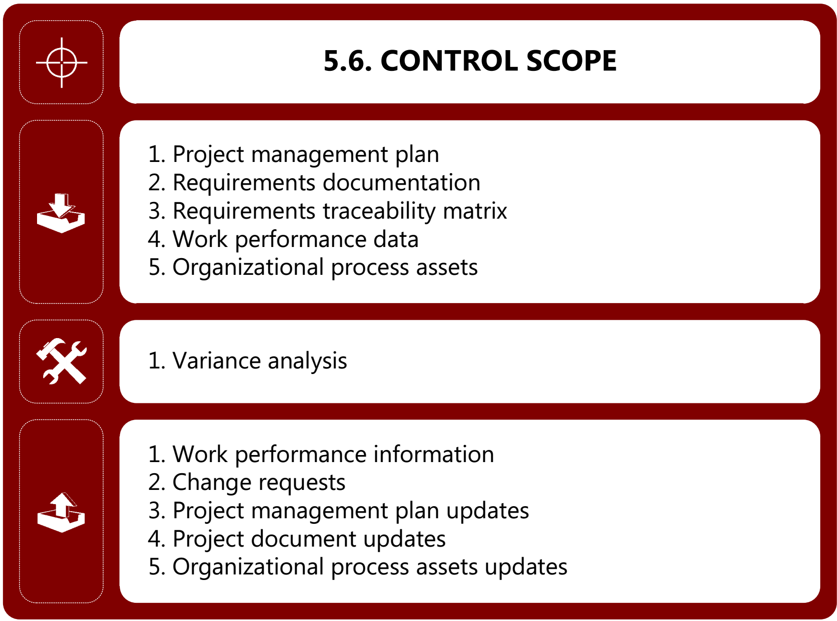
> ITTO

Slide 122
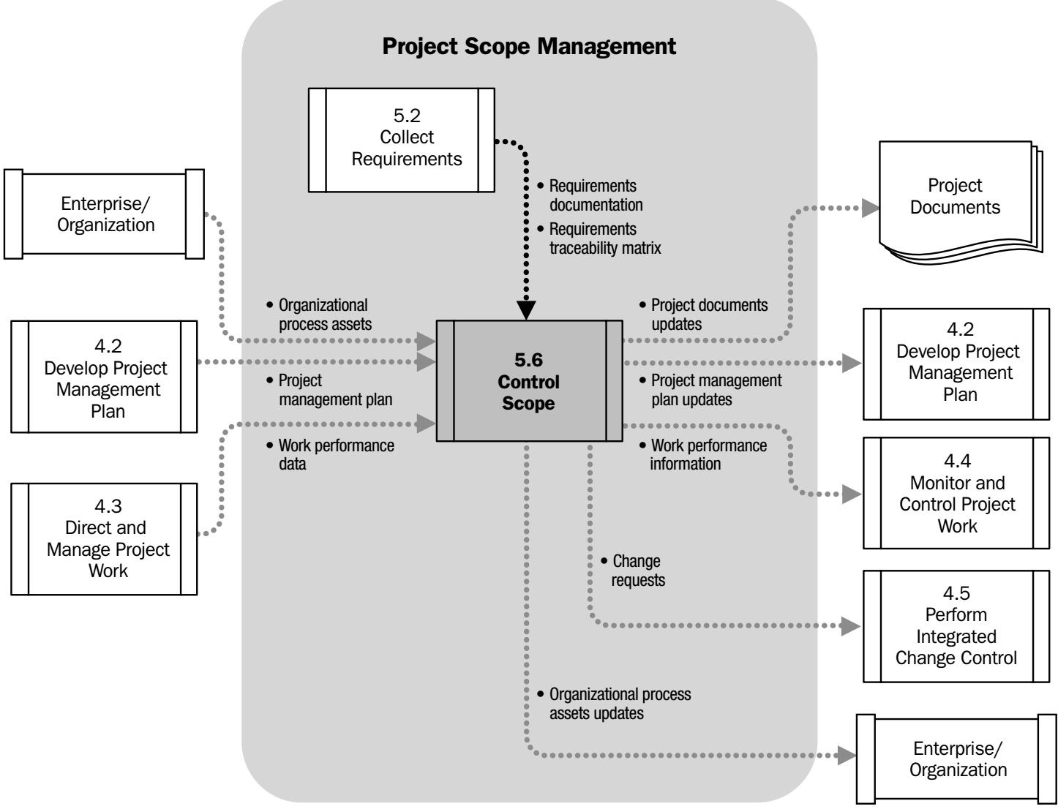
> Process Flow

Slide 123
> Input
Notes:
ITTO: Input Tool & Technique Output

Slide 124
> Input
Project management plan
Scope baseline, Scope management plan, change management plan, configuration management plan and requirement management plan

Slide 125
> Input
Requirements documentation
Requirements should be unambiguous, traceable, complete, consistence and acceptable to all stakeholders
Refer to Template\3.2_Requirements Documentation.doc
Requirements traceability matrix
Help to detect the impact of any change or deviation from the scope baseline on the project objectives
Refer to Template\3.4_Requirement Tracebility Matrix.doc

Slide 126
> Input
Work performance data
Number of change request received, number of request accepted and number of deliverables produced
Organizational process assets
Existing formal or informal scope
Control related policies
Procedures, Guideline
Monitoring & reporting template

Slide 127
> Tool & Technique
Notes:
ITTO: Input Tool & Technique Output

Slide 128

> Tool & Technique
Variance analysis
Determine cause & degree of difference between baseline & actual performance
Help deciding whether corrective or preventive action is required
Notes:
Contractor conferences
Vendor conference
Pre-Bid conferences

Slide 129
> Output
Notes:
ITTO: Input Tool & Technique Output

Slide 130
> Output
Work performance information
How the project scope is performing compared to scope baseline. How they impact schedule & cost, forecast future scope performance
Change requests
Can be result of analysis of scope performance. Can include preventive or corrective action
Project management plan updates
Scope baseline and other baseline updates

Slide 131
> Output
Project document updates
Requirements document, requirement traceability matrix
Organizational process assets updates
Cause of variances, Corrective action chosen and reasons. Lesson learned

Slide 132
Summary
Scope management process
Scope baseline
Project scope statement
WBS – WBS dictionary
Requirement traceability matrix
Work package, Product scope
Product analysis
Verified deliverable
Brainstorming
Nominal group technique
Delphi technique
Group decision making
Requirement categories
Context diagram
Prototype
Observation

Slide 133
Next Objectives
Time management process
Schedule baseline
Schedule compression
Crashing
Fast tracking
Network diagram
Dependencies
Precedence diagramming method (PDM)
Critical path
Three-point estimating
Monte Carlo analysis
Bar charts
Milestone charts
Schedule model
Resource optimization
Critical path method
Rolling wave planning
And more.

Slide 134


Thank you

Slide 135

Relaxing …
Notes:
Quiz after studying lectures

Slide 136
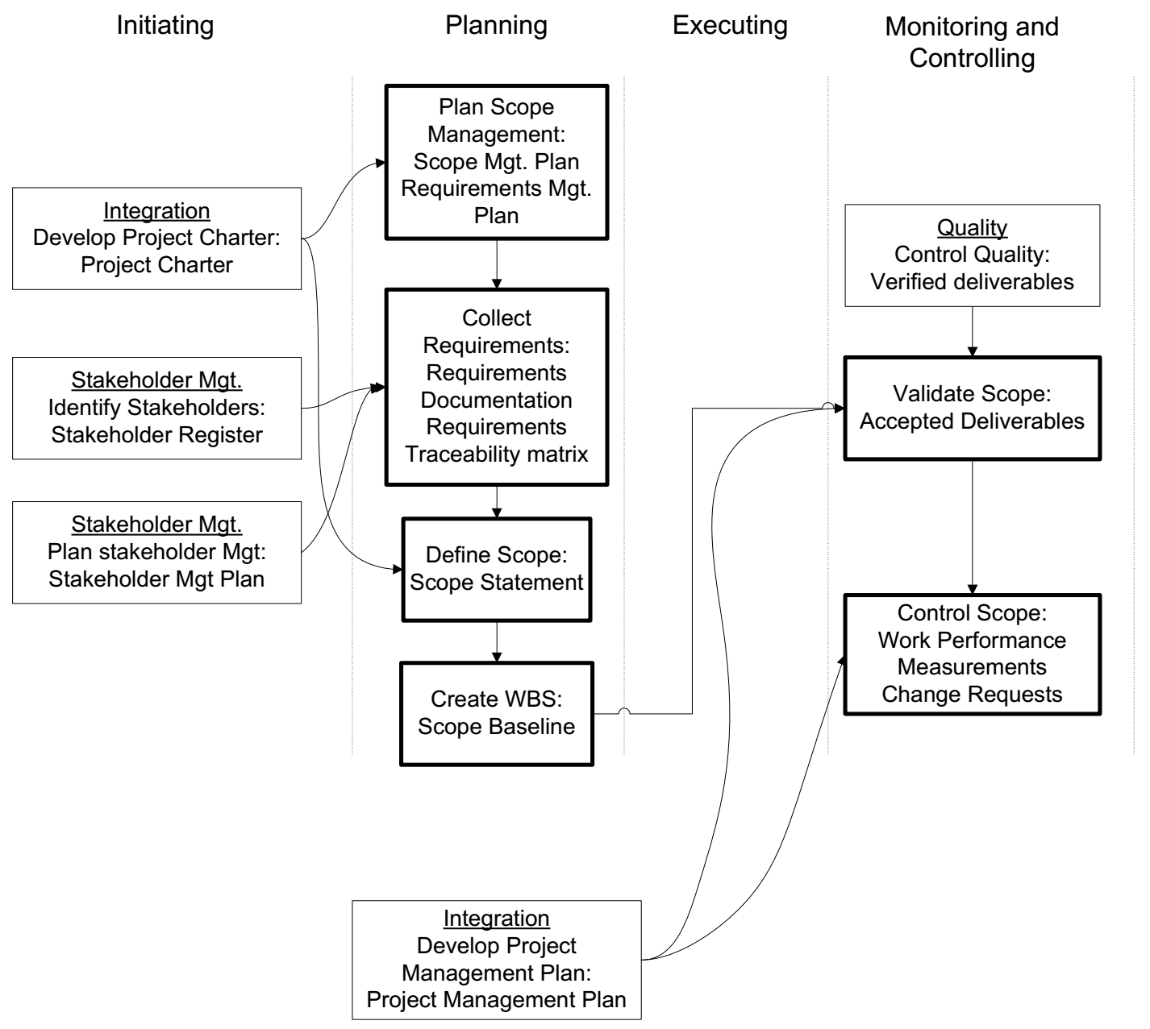
Process Interaction

Slide 137
Processes in scope management

Slide 138
Thank You

